Slide 1
Ideas by Gleb Astashkin
(aka gleb.astashkin)
ICPC 2023 Online Fall Challenge powered by Huawei

Slide 2
A few words about myself
It’s my third cash prize in the Huawei ICPC completions
I finished 7th, it’s my personal best
I used to work at telecommunication company, that’s why I know something about transmitting signals from base stations to client’s devices
It didn’t help me at all during the competition ☺

Slide 3
Speech plan
General approach – greedy solution to beat most of the cases
Packing multiple frames to one (cell, radio)
Unique approach to deal with low duration frames + low average D cases
Impressions and additional thoughts

Slide 4
General approach

Slide 5
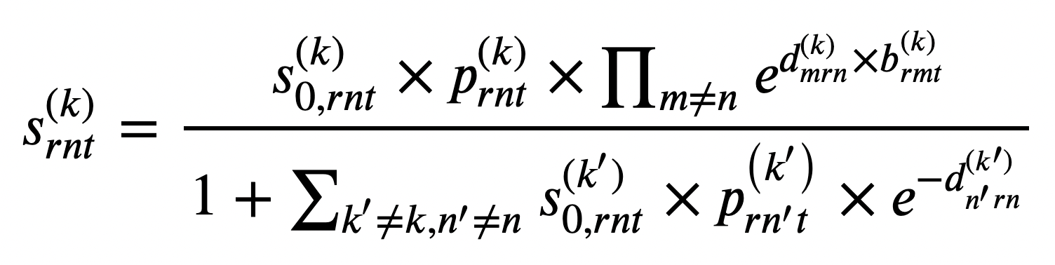
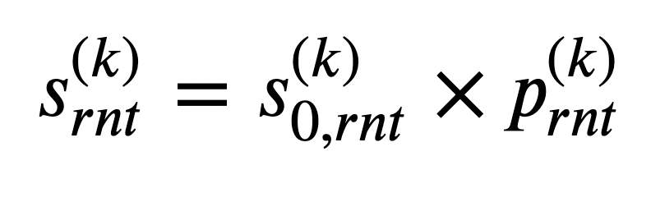
General approach
There is no penalty if an user occupies a radio exclusively
Let’s sort all the frames somehow, iterate through them and try to schedule them one by one greedy
Since radio resources are limited, we will try to minimize consumption of radio resources
And use power consumption as a tiebreaker

Slide 6
General approach – frame ordering
Since this is a heuristic, different way to order the frames leads to different results
Make multiple runs using different ordering and choose the best
We can order frames by:
Occupied radios
Occupied pairs (cell, radio)
Purely random
Combination of all above

Slide 7
General approach – extra tricks
Occupy only limited amount of power on the first run – set power limit for (cell, radio) to 1.0 instead of min(4.0, R). Utilize all the energy on the last run
Recalculate the order of frames based on already occupied resources, for example between the first and the last runs

Slide 8
General approach – multiple runs
Consider the case where:
K = 4
R = 5
First two cells have twice greater S₀ then, the others
There are 4 frames with total ‘size’ = 6
A frame occupies radio exclusively: 1 radio = 1 frame
S₀ | K₀ | K₁ | K₂ | K₃
R₀ | 2 | 2 | 1 | 1
R₁ | 2 | 2 | 1 | 1
R₂ | 2 | 2 | 1 | 1
R₃ | 2 | 2 | 1 | 1
R₄ | 2 | 2 | 1 | 1

Slide 9
General approach – multiple runs
Without power limit
Power limit = 1.0
P | K₀ | K₁ | K₂ | K₃ | Sum
R₀ | 3 | 0 | 0 | 0 | 6
R₁ | 2 | 1 | 0 | 0 | 6
R₂ | 0 | 3 | 0 | 0 | 6
R₃ | 0 | 1 | 4 | 0 | 6
R₄ | 0 | 0 | 1 | 4 | 5
Sum | 5 | 5 | 5 | 4
P | K₀ | K₁ | K₂ | K₃ | Sum
R₀ | 1 | 1 | 1 | 1 | 6
R₁ | 1 | 1 | 1 | 1 | 6
R₂ | 1 | 1 | 1 | 1 | 6
R₃ | 1 | 1 | 1 | 1 | 6
R₄ | 1 | 1 | 1 | 1 | 6
Sum | 5 | 5 | 5 | 5

Slide 10
Packing multiple frames to one (cell, radio)

Slide 11
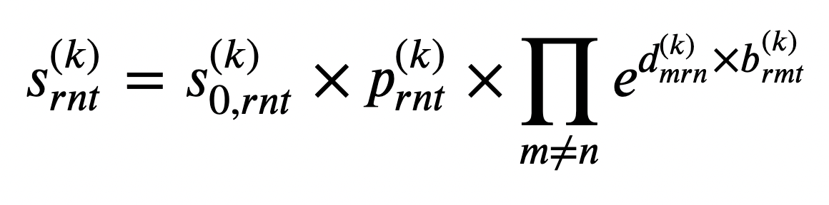
Packing multiple frames to one (cell, radio)
Penalty for doing that is not that big. It doesn’t involve P_{rnt} at all
Usually we have some leftover power, so we can utilize it by packing frames
It’s perfect when we have many 1 time unit duration frames
There’s no way to improve final score if average D is high enough

Slide 12
Packing multiple frames – algorithm
Since we share radio resources between multiple frames, we have to consider interference – frames influence to each other. Deal with it using following steps:
Assign all available frames to the chosen (cell, radio)
Use bin search to calculate minimum amount of power to complete the frame
Choose maximum subset of frames we can complete under given constraints
Add a few runner ups and repeat all previous steps
Stop if the subset of frames is stable

Slide 13
Unique approach for low duration frames and low average D cases

Slide 14
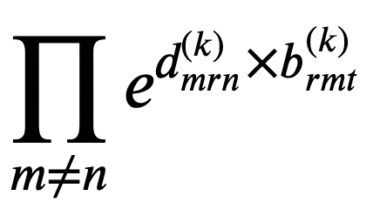
Unique approach
We are not allowed to use same radio on multiple cells due to high penalty
But we are allowed to use multiple radios for the same frame
Actually we can even share set of (cell, radio) between multiple frames
The only penalty is

Slide 15
Unique approach – set of (cell, radio)
P | K₀ | K₁ | K₂ | K₃ | Sum
R₀ | 4 |  |  |  | 4
R₁ |  | 4 |  |  | 4
R₂ |  |  | 4 |  | 4
R₃ |  |  |  | 2.5 | 2.5
R₄ |  |  |  | 2.5 | 2.5
Sum | 4 | 4 | 4 | 5
Choose the set of (cell, radio) in such way, that:
A radio used by only one cell
Maximum number of radios assigned to a single cell is as lower as possible
Then choose maximum subset of frames using algorithm from the previous part and scheduling each frame to all chosen (cell, radio) at once

Slide 16
Unique approach – a little trick
Some of the frames are so small we can schedule them to a smaller amount of radios (perhaps 1 or 2)
Assign them only on orange (cell, radio)s
It slightly reduces penalty for all the other frames scheduled on green (cell, radios)
Make it in two runs:
Assign some frames only on orange (cell, radio)s
Try to assign maximum number of unassigned frames on all (cell, radio)s: both green and orange
P | K₀ | K₁ | K₂ | K₃ | Sum
R₀ | 4 |  |  |  | 4
R₁ |  | 4 |  |  | 4
R₂ |  |  | 4 |  | 4
R₃ |  |  |  | 2.5 | 2.5
R₄ |  |  |  | 2.5 | 2.5
Sum | 4 | 4 | 4 | 5

Slide 17
Impressions and additional thoughts

Slide 18
Impressions and additional thoughts
All the formulas seemed scary at first, but turned out it was not that bad
Low TL made feedback loop short and convenient. Also it made the problem deeper, since we have not enough runtime to do classical SA
Shared testcases made local debugging possible. I like that number of them was small to prevent overfitting
Once again I don’t think probing is a problem. At least system tests deal well with overfitted solutions
Difference between preliminary and system tests was small. Set of top-10 competitors didn’t change after the system tests. That’s a good sign
Overall it was a great contest! I really enjoyed it. Thank you!

Slide 19
Telegram: @gvastash
Linkedin: linkedin.com/in/gvastash
Thank you for your attention!
謝謝你！

